Slide 1
Usability Toolkit for Clinical Reminder Dialogue Templates
Project briefing
January, 3, 2019
Facilitated by: Ross Speir
Human Factors Engineering, Health Informatics Division
Office of Health Informatics (10A7)
Veterans Health Administration

Slide 2
Project Team
Ross Speir
Program Manager, Usability Engineer
OHI Human Factors Engineering
Scott Wood, PhD
Health System Specialist, Human-Computer Interaction and Clinical Decision Support
OHI Knowledge Based Systems
Kas Adams
Informatics Evaluation Manager
Northwest Innovation Center
Crystal Rojas
Quality Consultant, Informatics Nurse Specialist
VA Long Beach Healthcare System
Stephanie Tallett
Human Factors Analyst
Northwest Innovation Center

Slide 3
Purpose
Create a versatile process with constituent techniques and tools that support a human-centered approach to the development of highly usable clinical reminder dialogue templates.
Enable opt-in usage by
representatives of the clinical service(s)
template developers (CACs)
usability practitioners (from HFE)
field informaticians (at pilot sites)
end users

Slide 4
Problem Statement
Issues
Lack of standardization in the design of clinical reminder dialogue templates (CRDTs)
Lack of awareness and utilization of usability techniques by individuals involved in CRDT design, development, testing, and implementation
Impact
Resulting templates may have usability problems (negatively impacting clinician effectiveness and efficiency)
Resulting templates may lack, or use inconsistently, structured data
The development process for CRDTs may be suboptimal (resulting in wasted effort, delays getting templates into the field)
Opportunity
Provide tools, best practices, and structured process for developing highly-usable CRDTs. Enable teams to customize the process to meet their project needs/constraints. Enable the utilization of tools outside of a recommended process.
Notes:
[ ] The "Problems" slide that is showing is a variation on the "Who Cares" question of the Value Proposition

Slide 5
Problems to address
Poor template usability
Increases unnecessary HIT burden on end users
Decreases care delivery efficiency
Decreases care delivery effectiveness
Decreases end user satisfaction
Increases field informatics workload regarding support and maintenance
Lack of usability resources for clinical reminder templates
Increases variability in CRDT quality
Increases development time
Increases maintenance costs from poor usability incidents
Decreases traceability of design decisions

Slide 6
Current Approach - Assumptions
Local templates
Lack of standards across VA or even within site; lack of a rigorous design process
May be an iterative content review and development process, but with no formal specification of usability objectives
Infrequent site-based usability evaluations (HE, usability testing, observation, walkthroughs, satisfaction surveys, etc.)
National templates
HFE office conducts a usability assessment on most nationally developed templates; many findings are often avoidable
Assessment rigor may be dependent on availability of HFE practitioners
Formal usability testing is not carried out at pilot sites

Slide 7
Proposed Solution
Tailor the human-centered design approach for CRDT development
Produce a set of techniques for planning, defining objectives, designing, evaluating, and implementing CRDTs
Tailor the techniques through use with national template development and at VAMC sites
Pilot the toolkit with national and local template development projects
Develop necessary training to use toolkit
Make toolkit available for self-service within UX Guide

Slide 8






Concept: Usability Toolkit
Collection of tools and guidance that enhance VA’s collective intelligence to develop and implement effective CRDTs.
Capture goals of intended use
Apply HCI Principles
and UI Patterns
Enable rapid assessments of template usability
Domain
experts
Template Developers
Usability Specialists
End
Users

Slide 9
Concept: Usability Toolkit
Rationale for a ‘Usability’ Toolkit
Usability is a measure of general quality for interactive systems. (ISO 9241-11:2018)
For clinician-facing HIT systems, usability reflects the ‘goodness of fit’ of the technology to the clinical work and tasks.
The Usability Toolkit will address
Ease of use / ease of learning
Efficient use
Alignment with clinical workflow
Clinical decision-making / Cognitive burden
Support of care team coordination
Risks of use error

Slide 10
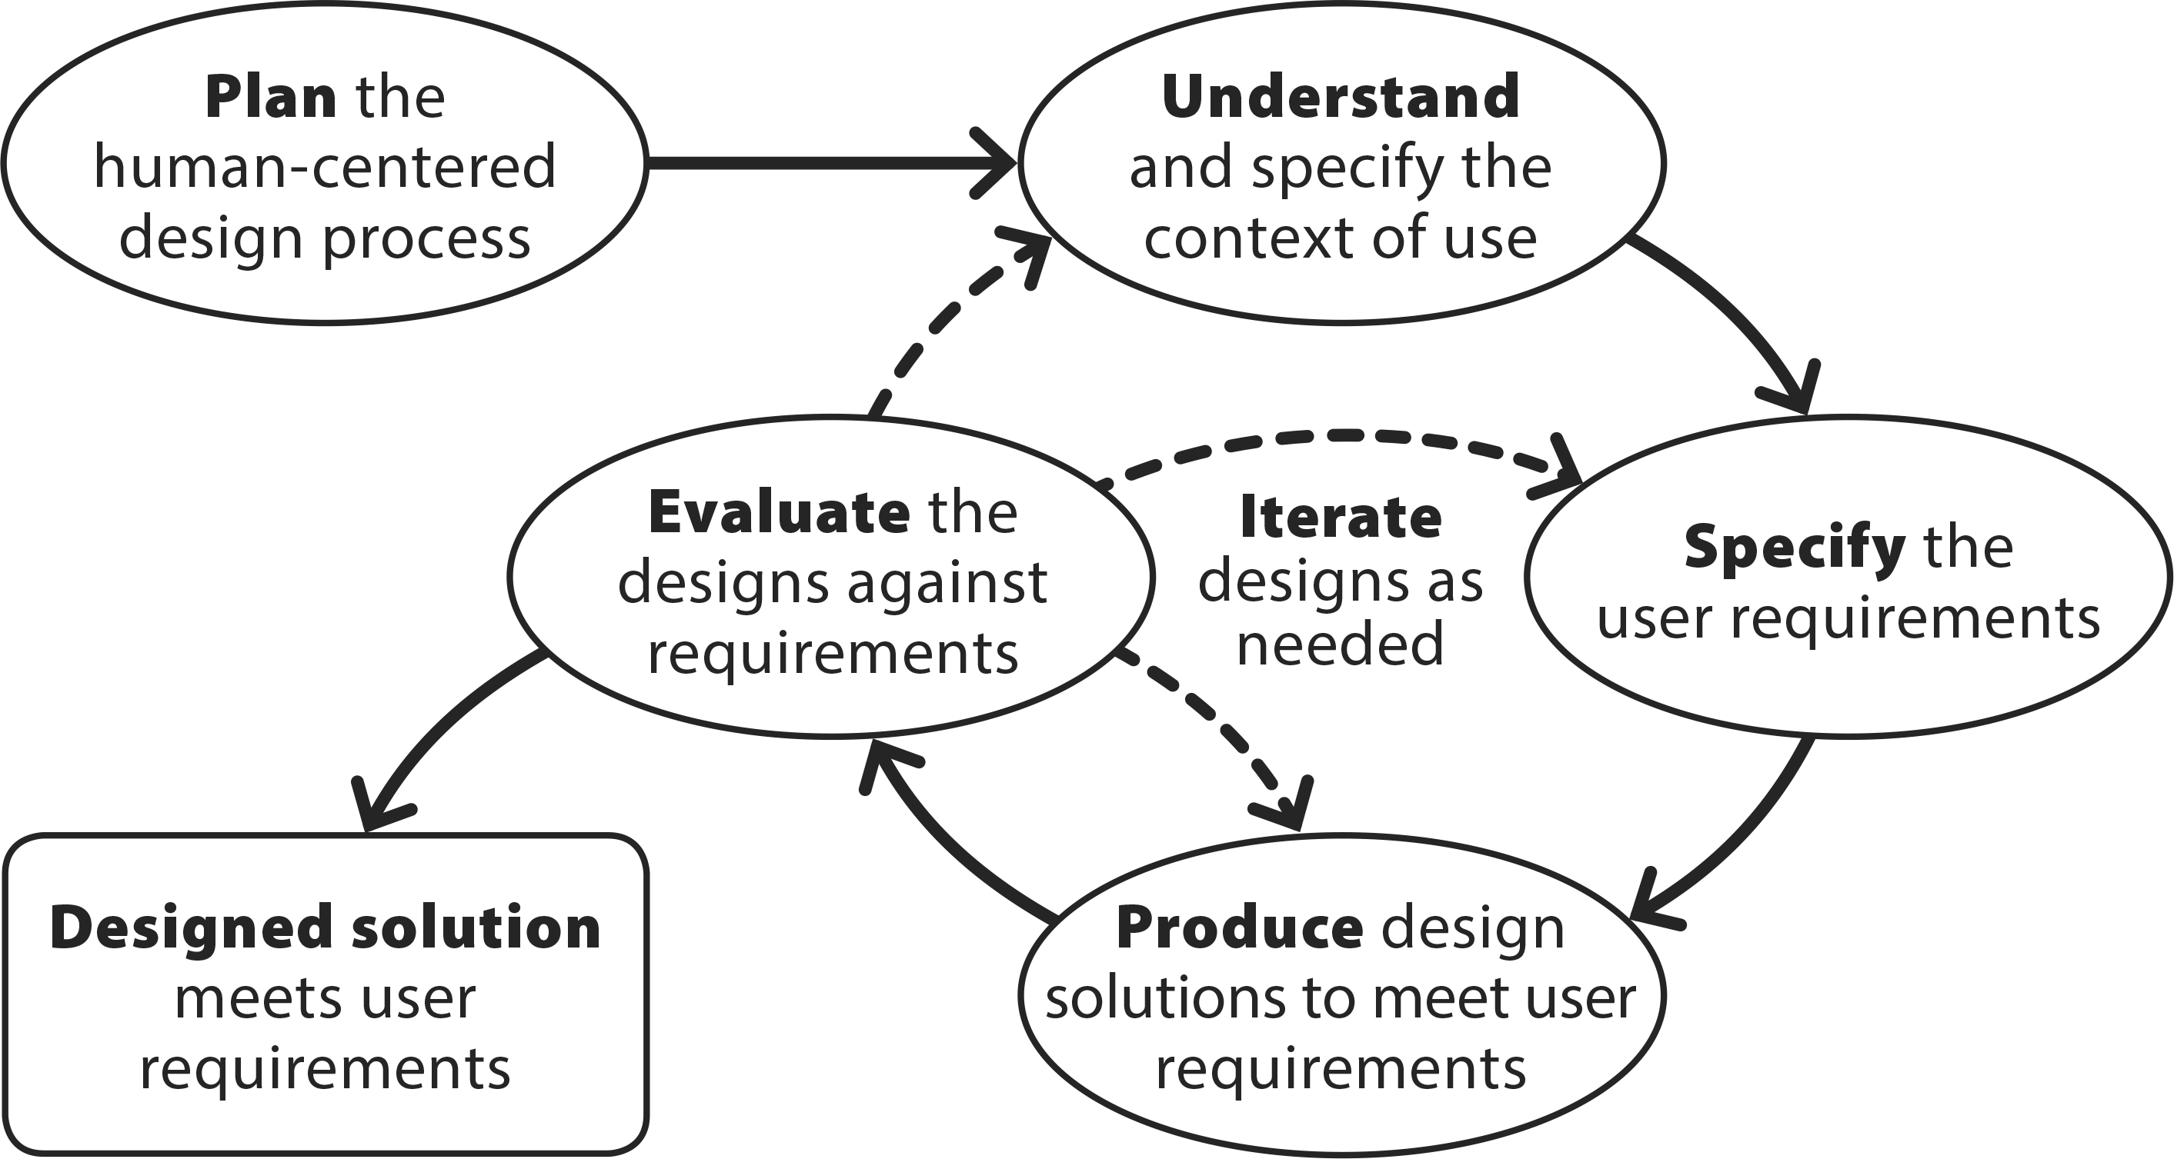
Human-centered Design
Design usability into the development process
Adapted from ISO 9241-210

Slide 11
Human-centered Design
Design usability into the development process
Guidance to scope and implement HCD
Tools and template to capture of users, tasks, workflow, scenarios.
Tools for assessing usability
Specification of intended use and use risks
Design principles and UI Patterns
Adapted from ISO 9241-210

Slide 12
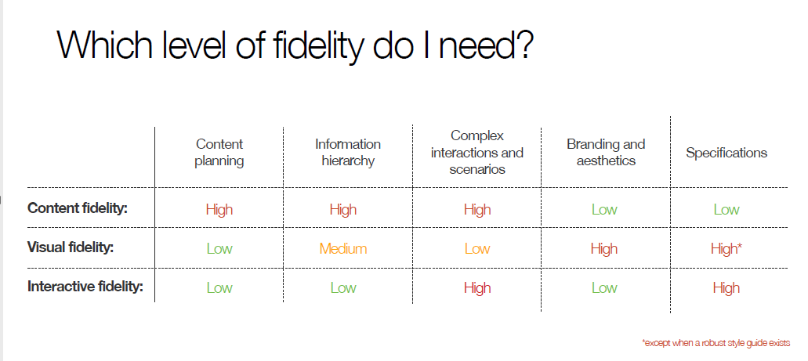
DRAFT
“I wonder how content/interactive fidelity could be referenced during the iterate phase- start simple or go all in? Maybe that needs a single slide for discussion. NNg has a good slide we can use as basis for what type of fidelity you should use. I think most templates focus on complex interactions or information hierarchy (detailed steps vs checkbox).” -KR
“Agreed. And the specification of usability objectives will enable to the team identify the biggest risks / complexities – this should help focus early iterations.” -RS
In addition to design fidelity, there’s the recommendation to start with the overall workflow and information flow, and then the user task-flow.
Refer to Ginnifer’s research about HIT trust. “Design with Increasing Fidelity” (If users see something that looks like they can interact with, they expect it to work.)
Design iterations

Slide 13
Benefits of a Successful Conclusion
Improved standards for CRDT development, resulting in
Robust, value-driven, work-centric process
Toolkit focused on needs of busy clinical and support staff (business owners, CACs, HISs, usability specialists)
Improved quality of CRDT products, resulting in
Improved clinician satisfaction and efficiency
Improved patient care and health outcomes
Reduced burden on clinicians and clinician burnout

Slide 14

Future directions
Advanced training ‘bootcamp’ for clinical Informaticists
Usability Toolkit for other HIT applications
Clinical Reminder Dialogue Templates
Referral Templates (service agreements)
Order Sets
After-visit Summaries
other HIT applications?

Slide 15
Project Approach
Agile
Specific objectives, short-term sprints
Deliver immediate value
Human-centered
Integrate into template development process
Iterate solutions with end users
Systems-based
Address various users and teams involved in the process
Measure impact and value

Slide 16
Phased Approach
Incremental objectives
Phase 1
Develop v1 Toolkit
Phase 2
Explore use for local templates
Engage with VAMC CHIOs
Develop v2 Toolkit
Upload content to the UX Guide
Engage SMEs
Pilot with national CRDT projects
Support adoption in national CRDT process
Evaluate toolkit usage
Develop v3 Toolkit
Determine training needs
Initiate training project
Establish maintenance process
Promote usage
Phase 3

